Slide 1

Molecular Structure Calculator
Presented by:
Ya’eer Kidron & Yair Toledano

Slide 2

Lewis Model
A diagrams that show the bonding between atoms of a molecule
Our Molecular-Structure Calculator algorithm is based on the electron's configuration of all the elements in the periodic-table by the Madelung rule.
For each molecule formulae the calculator will be able to construct visually its Lewis Model.
The algorithm takes into consideration all the possible oxidation states of each atom, and the ionic/covalent bonds between the atoms.
Note - Lewis structure does NOT attempt to explain the geometry of molecules, how the bonds form, or how the electrons are shared between the atoms. It is the simplest and most limited theory on electronic structure.

Slide 3
Algorithm
Building a dictionary where for every element there are the available bonds
Use a predefined periodic table dictionary and formulae, split the chemical formulae string into the different elements, including dealing with parenthesis
Recursive function that builds the molecule, runs through elements to bond the different atoms based on Madelung rule.
First Class – Atom:
Represents a molecule atom with it's bonds
Second Class – ChemistryFormulae:
  Represent a chemistry formula if the initialization succeeds
  The algorithm uses a Brute force approach for searching the correct bonds between the atoms
Drawing the bonding between atoms of a molecule

Slide 4
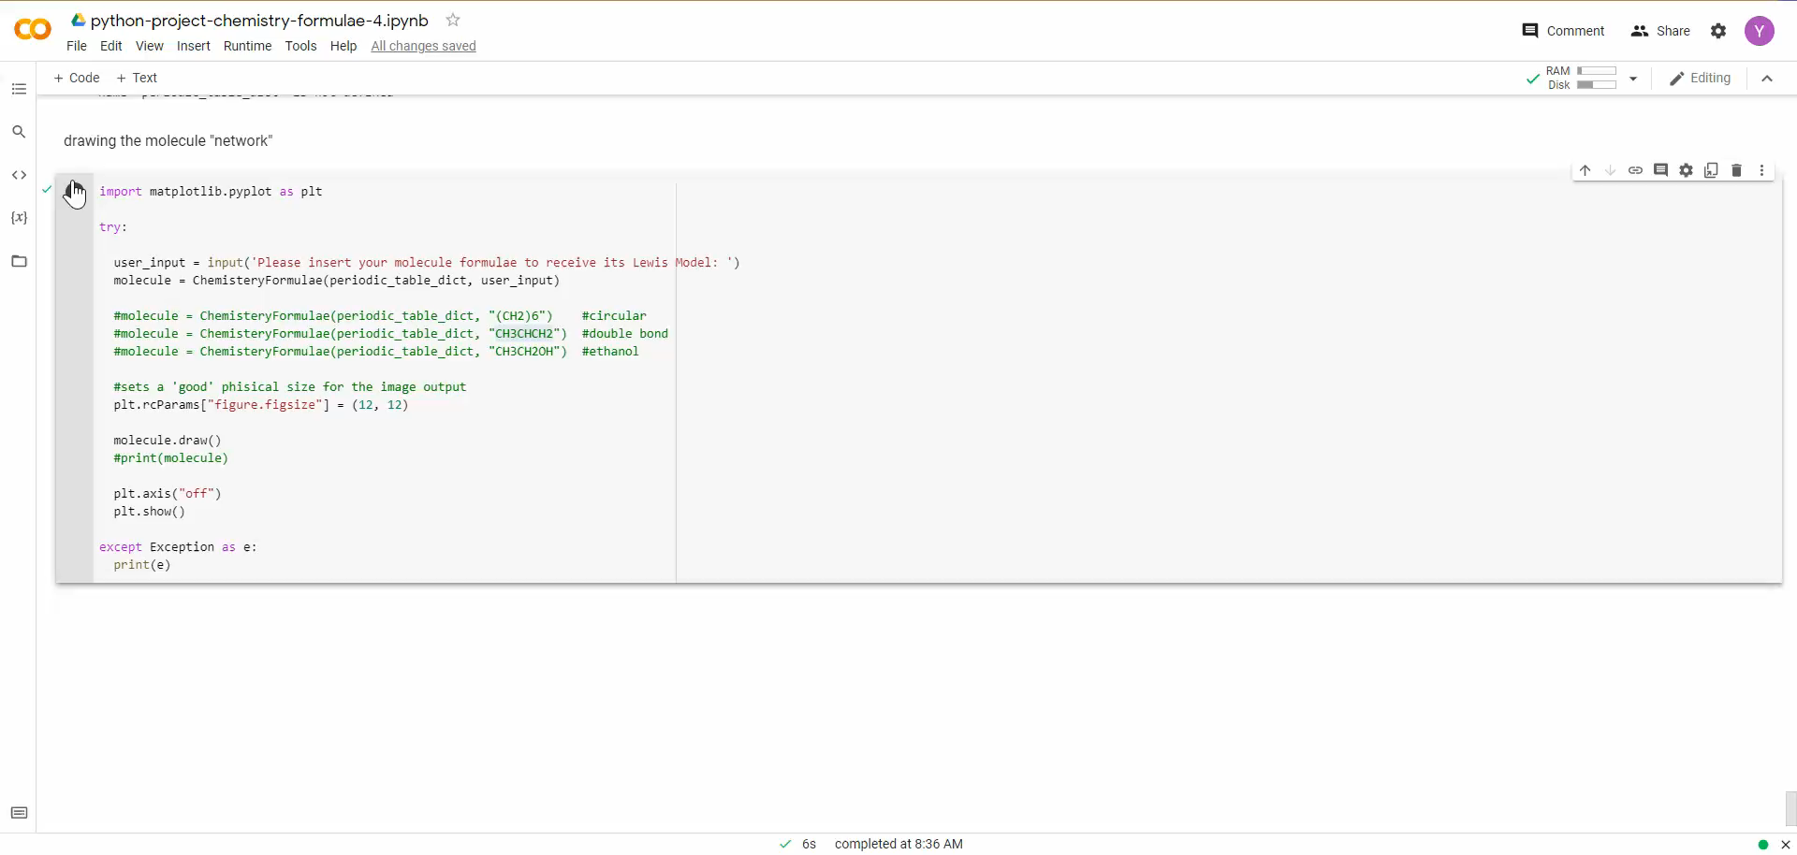
Input & Output

Slide 5


Thank You
Ya’eer Kidron
Yair Toledano
https://github.com/Yrto92/Data_Science

